Slide 1
Predicting Markets for Solar Installation

Slide 2
Project Goals
-Identify markets where solar panel installation is higher than average.
-Generate model to predict markets for which no validation data is available.
-Map the results of the data across the United States to visualize market patterns.
-Identify metrics that effect market evaluation through analysis of various use case scenarios.

Slide 3
Data Prep
Data Sources:
  -Kaggle’s Google Project Sunroof,
  -Scraped Data from NREL
  -Scraped Data from US Census
  -Property Pricing Data From Zillow.

Slide 4
Data Prep
Project Sunroof Useful Data:
  -Region: Geographic Region of collected data, Zip Code
  -Percent Covered: % of roofs in geographic region evaluated. Useful in eliminating samples that contain incomplete data.
  -Number of Installs: Number of solar panel installations in zip code

Slide 5
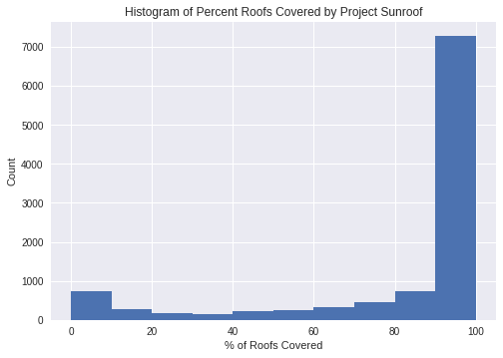
Data Prep
Project Sunroof Data Original Data:
10,620 entries
-Percent Covered
Greater than 90%:
7280 entries

Slide 6
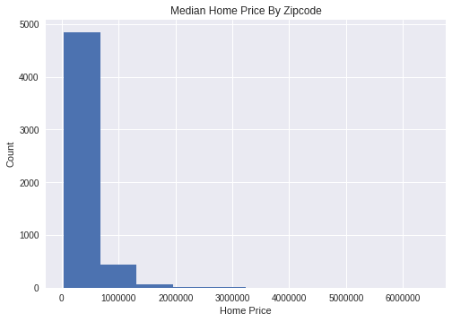
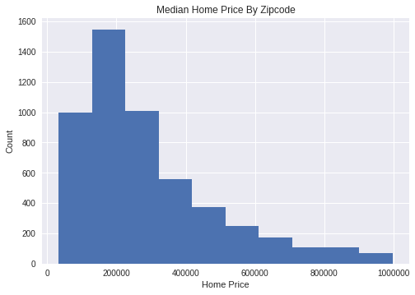
Data Prep
Zillow Median House Price Data:
Dropping Outliers above 1,000,000 USD
13,500 Entries

Slide 7
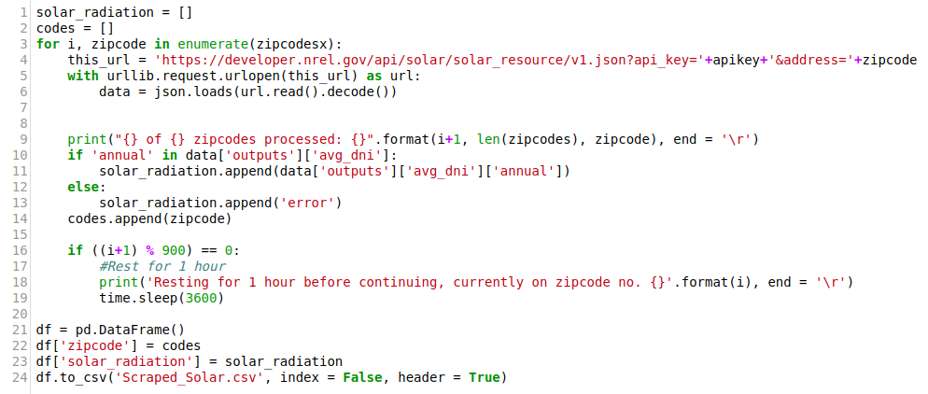
Data Prep
NREL Data Scraping:
Simple Iterative API scrape: 40,543 entries

Slide 8
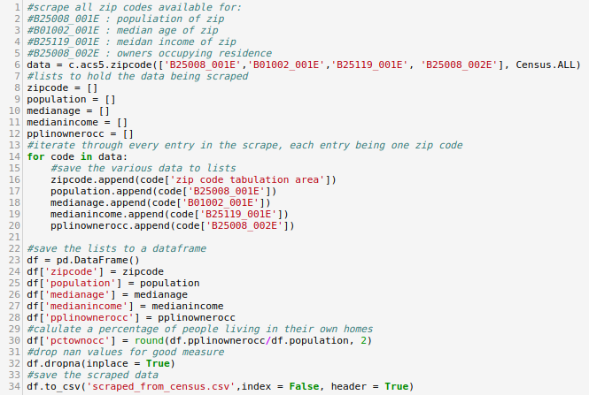
Data Prep
Census.gov Scraping
Single API Scrape: 28,067 entries

Slide 9
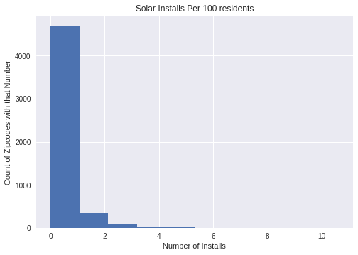
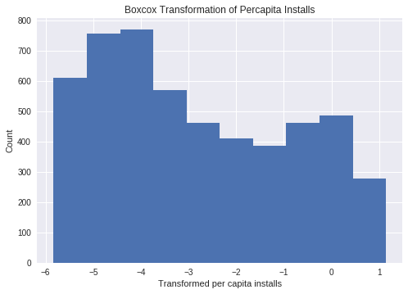
Data Prep
Feature Engineering:
Per Capita Installs BoxCox Transform

Slide 10
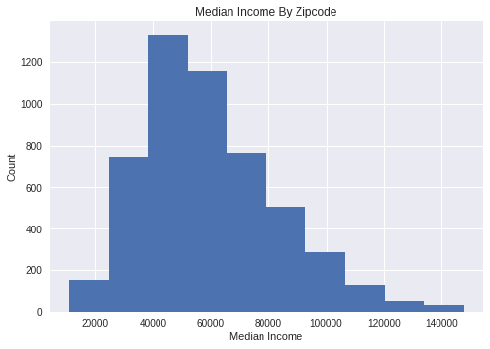
Data Prep
Feature Analysis:

Slide 11
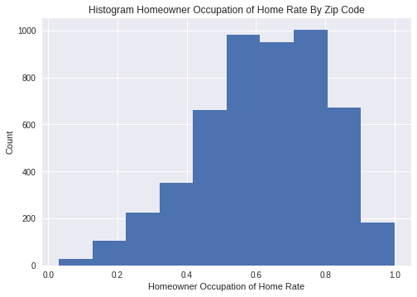
Data Prep
Feature Analysis:

Slide 12
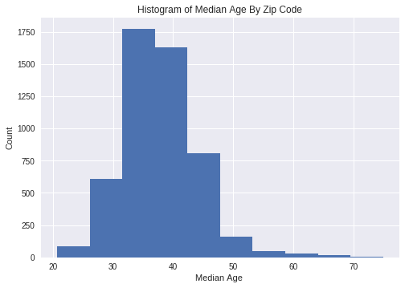
Data Prep
Feature Analysis:

Slide 13
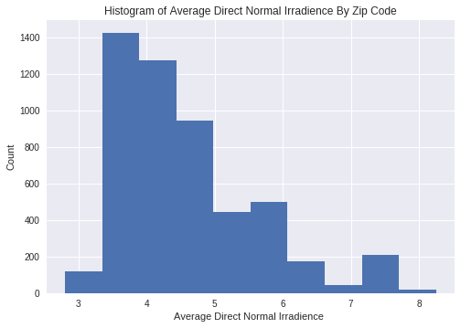
Data Prep
Feature Analysis:

Slide 14
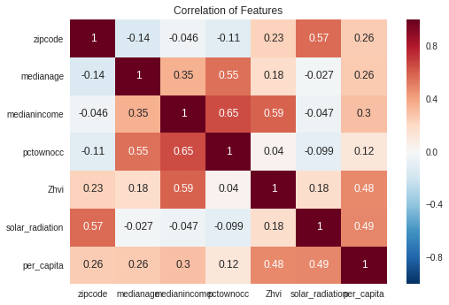
Data Prep
Feature Correlation:

Slide 15
Data Prep : 2 class modeling
Feature Engineering:
  Split the per capita feature into above median and below median

Slide 16
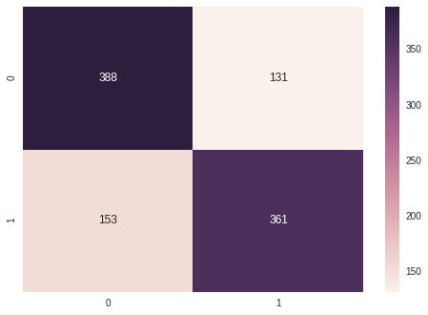
2 Class Model Building
Logistic Regression:
Train 80% Test 20% - Accuracy: 72.5%

Slide 17
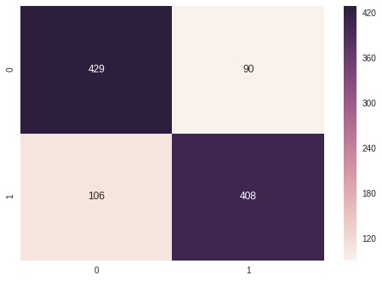
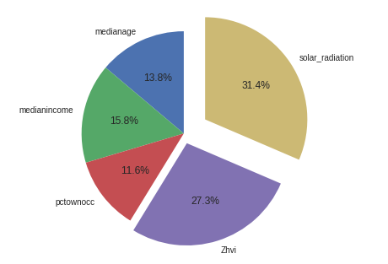
2 Class Model Building
Random Forests:
Train 80% Test 20% - Accuracy: 81.4%

Slide 18
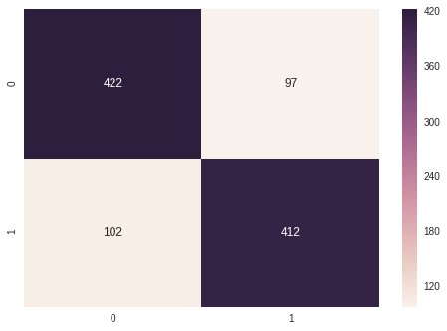
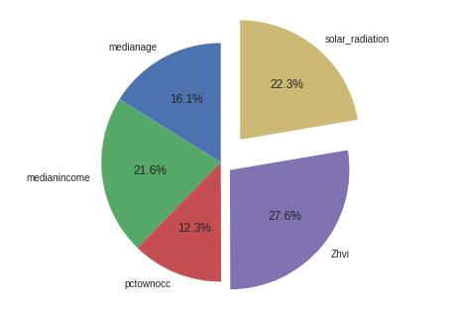
2 Class Model Building
Gradient Boosting:
Train 80% Test 20% - Accuracy: 80%

Slide 19
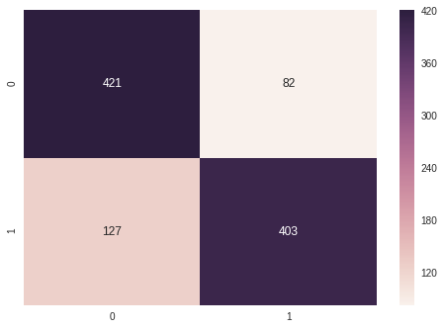
2 Class Model Building
Ensemble Model:
Train 80% Test 20% - Accuracy: 79.7%

Slide 20
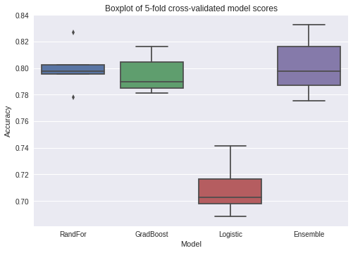
2 Class Model Analysis Of Results
Review of Model Performance:

Slide 21
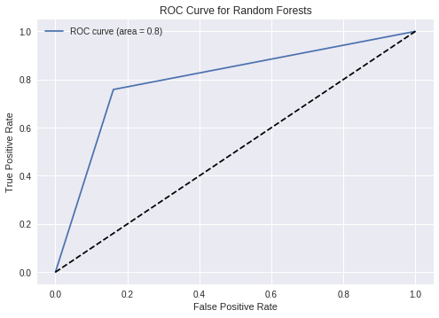
2 Class Model Analysis Of Results
ROC Curve:

Slide 22
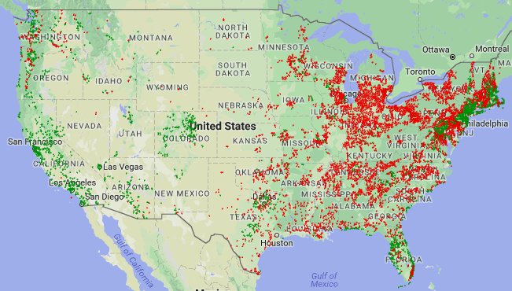
2 Class Model Plot Results

Slide 23
3 Class Modeling
-Proof of concept via 2 class modeling
-Try 3 class modeling to get more granular results from model.
  -Engineer ground truth for bottom 3rd, middle 3rd, and top 3rd of per capita installs.

Slide 24
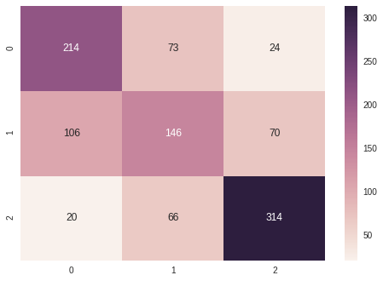
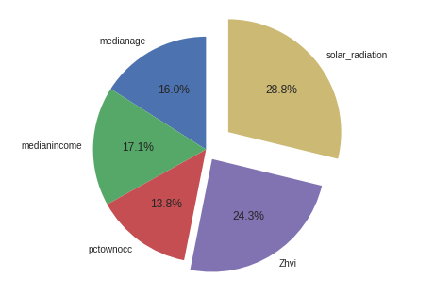
3 Class Model Building
Random Forests:
Train 80% Test 20% - Accuracy: 62%

Slide 25
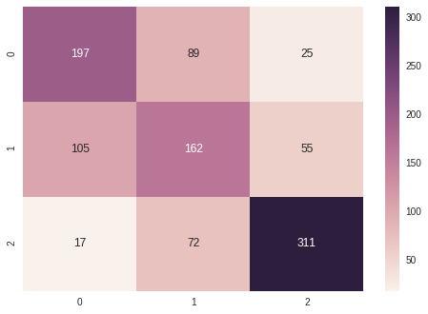
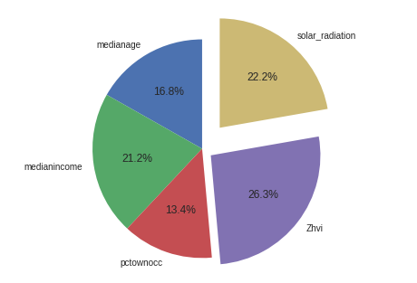
3 Class Model Building
Gradient Boosting:
Train 80% Test 20% - Accuracy: 61%

Slide 26
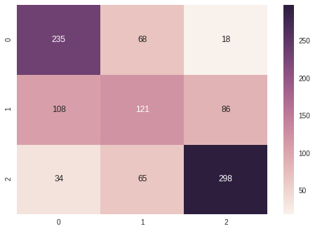
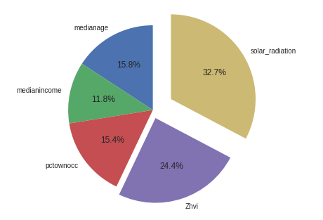
3 Class Model Building
XG Boost:
Train 80% Test 20% - Accuracy: 62.2%

Slide 27
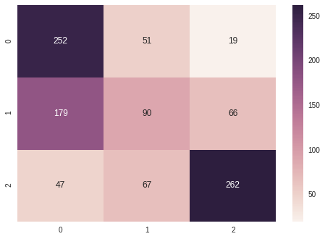
3 Class Model Building
Support Vector Machines:
Train 80% Test 20% - Accuracy: 58.4%

Slide 28
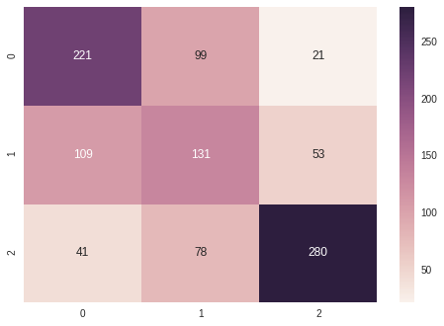
3 Class Model Building
KNN Classifier:
Train 80% Test 20% - Accuracy: 61.1%

Slide 29
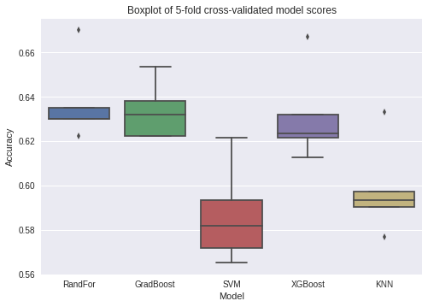
3 Class Model Analysis Of Results
Review of Model Performance:

Slide 30
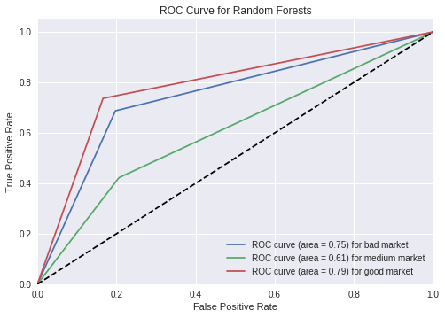
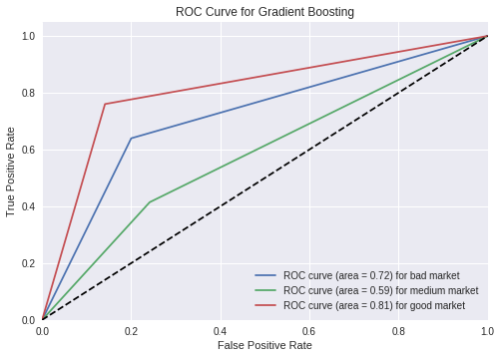
3 Class Model Analysis Of Results
ROC Curve:
      Random Forests Gradient Boosting

Slide 31
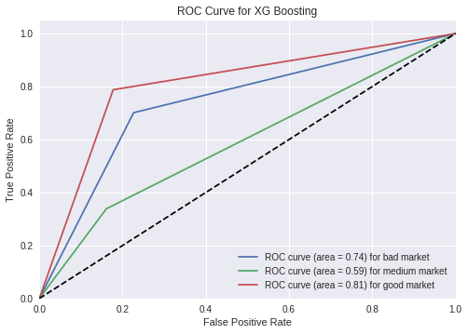
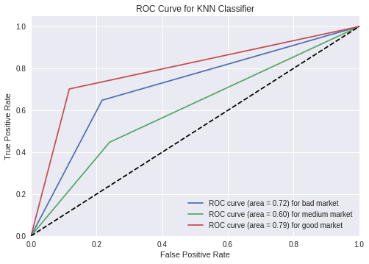
3 Class Model Analysis Of Results
ROC Curve:
      XG Boost KNN Classifier

Slide 32
3 Class Model Analysis Of Results
-ROC Curve and Cross Val Score Analysis
  -Random Forest AUC for good markets strong
  -Random Forest Average CV score strong and stable

Slide 33
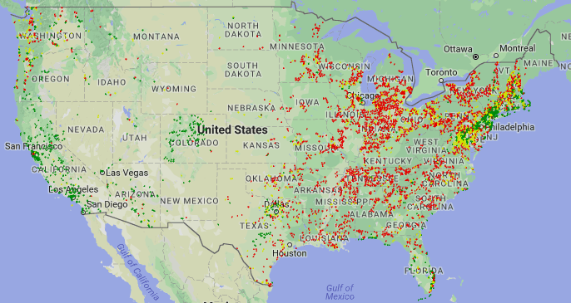
3 Class Model Plot Results

Slide 34
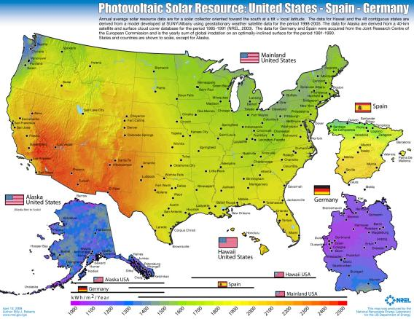
3 Class Model In-Depth Analysis

Slide 35
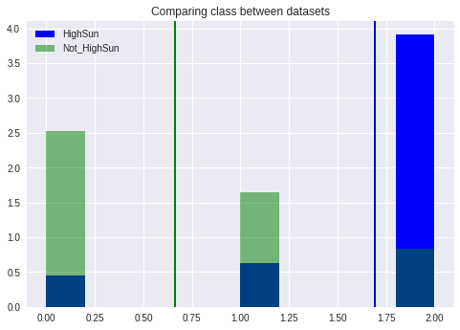
3 Class Model In-Depth Analysis

Slide 36
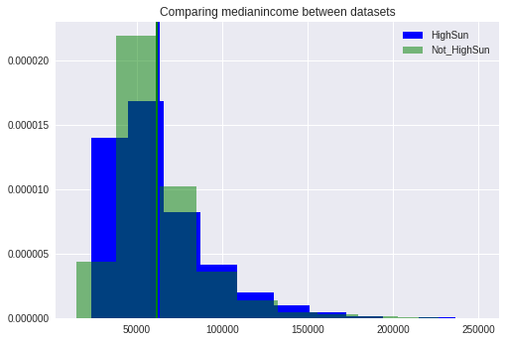
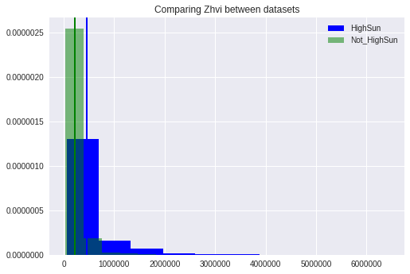
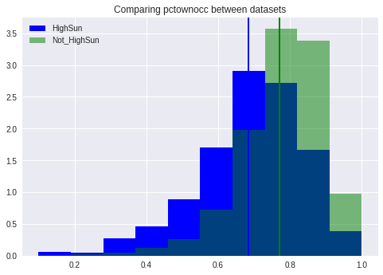
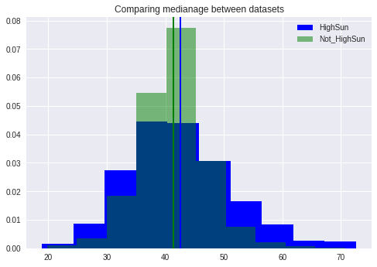
3 Class Model In-Depth Analysis

Slide 37
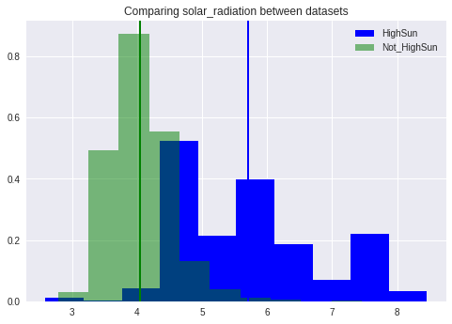
3 Class Model In-Depth Analysis

Slide 38
3 Class Model In-Depth Analysis
High Sun-Regions Vs Low-Sun Regions:
  -No significant differences other than sun
  -Still high number of all three market classifications

Slide 39
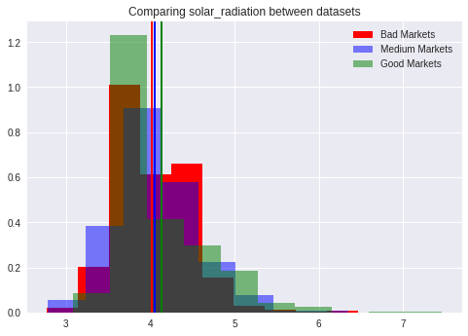
3 Class Model In-Depth Analysis
Variance in Solar Radiation in Low Sun Markets

Slide 40
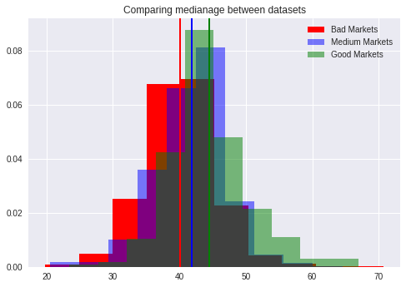
3 Class Model In-Depth Analysis
Variance in Median Age in Low Sun Markets

Slide 41
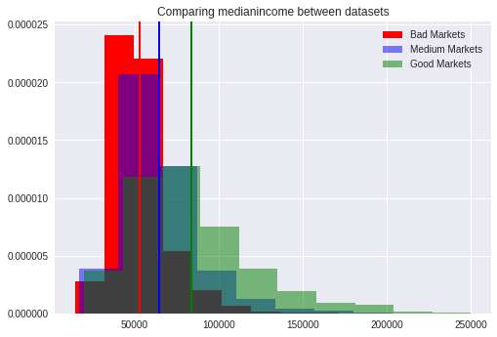
3 Class Model In-Depth Analysis
Variance in Median Income in Low Sun Markets

Slide 42
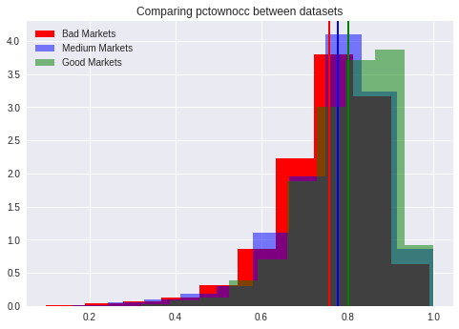
3 Class Model In-Depth Analysis
Variance in Home Ownership Rates in Low Sun Markets

Slide 43
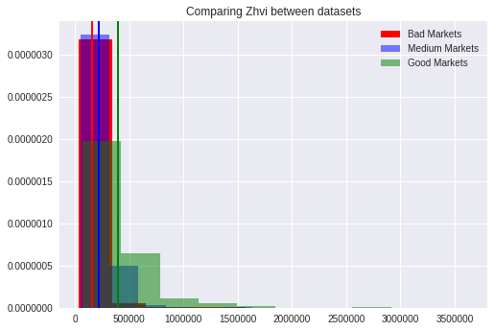
3 Class Model In-Depth Analysis
Variance in Home Value in Low Sun Markets

Slide 44
3 Class Model In-Depth Analysis
Differences between markets seem negligible
  -Causes for classification must be more nuanced
  -Best to evaluate specific use cases to see if different patterns become clear.
  -Might be possible combination of multiple feature contributing to defining the multiple classes

Slide 45
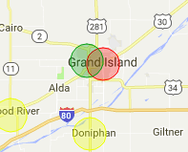
3 Class In-Depth Use Case Analysis
Grand Island, NE

Slide 46
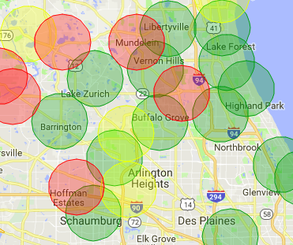
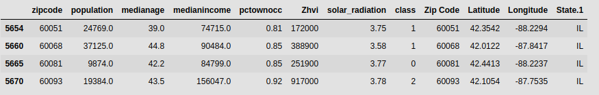
3 Class In-Depth Use Case Analysis
North Chicago, IL

Slide 47


3 Class In-Depth Use Case Analysis
San Francisco, CA

Slide 48


3 Class In-Depth Use Case Analysis
Washington, DC

Slide 49
Future work slide
-Find a more complete database of median housing prices
-Gathering additional features from census.gov or other locations.
-Running genetic algorithms to come up with different modeling parameters that might shed let on a more effective model.
-Separate Models for highsun and lowsun regions
-Break down into more classes for additional granularity

Slide 50
Conclusion
- Identified major features using multiple modeling techniques for market reception of solar panel installations
- Model relevant data can be used by the solar financing to design marketing campaigns
- Installation service companies can use the approach for planning expansion of services

